Slide 1
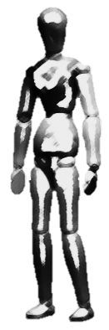


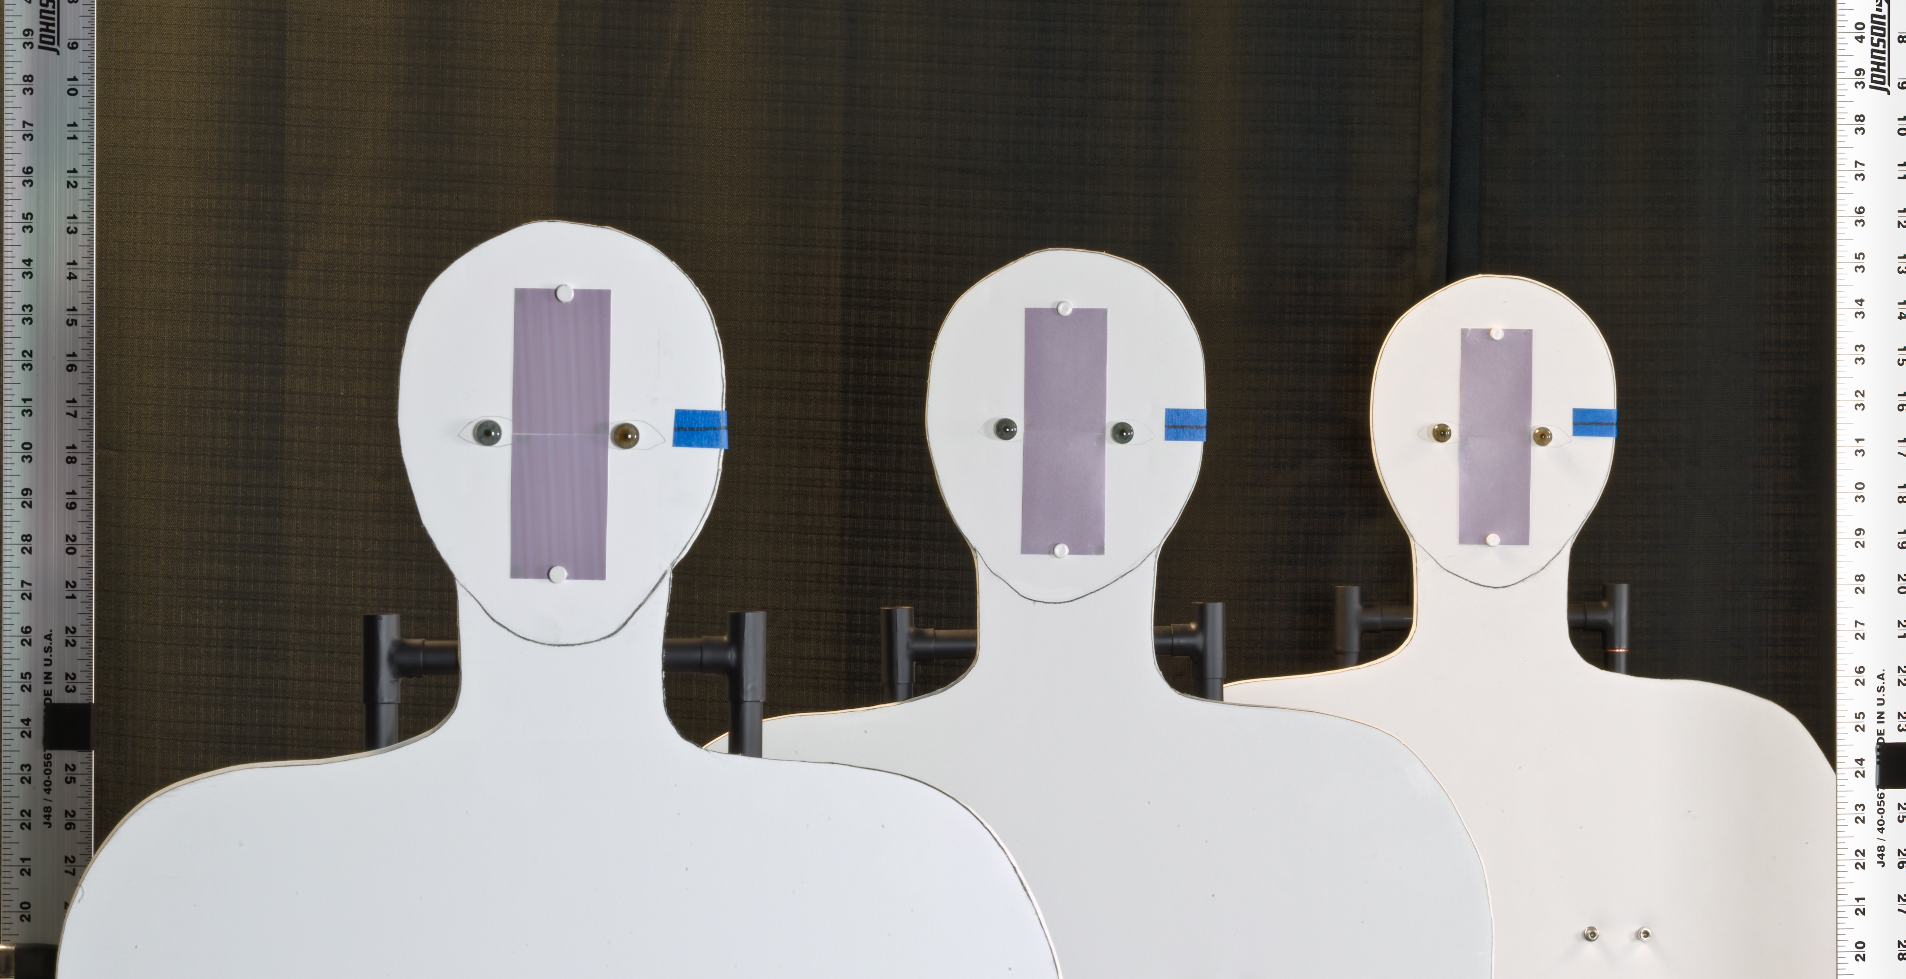
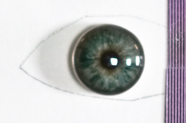

Demonstration of capture volume improvement
0.61 m
0.61 m
4.038 m
Setup
180 mm, F/8
Artificial iris
Ø 11 mm
Camera’s view
Pattern (2 lp/mm)
mm

Slide 2
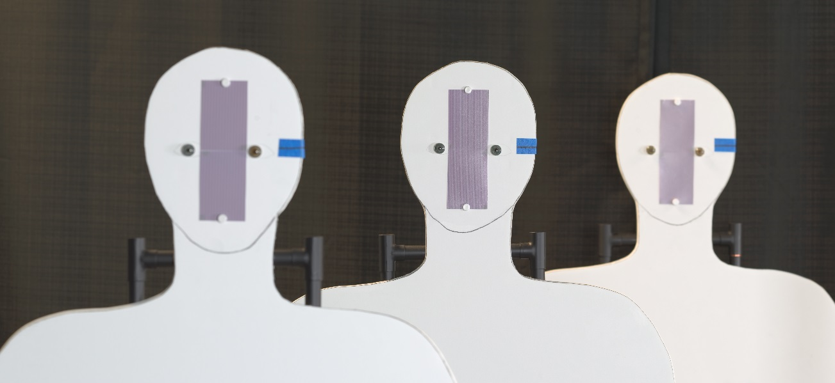
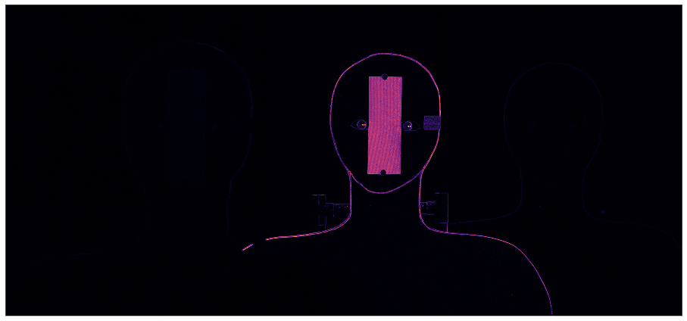
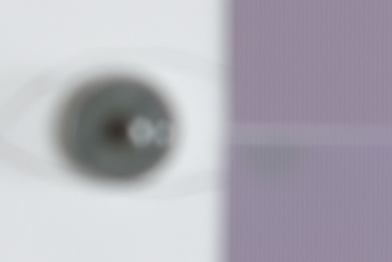
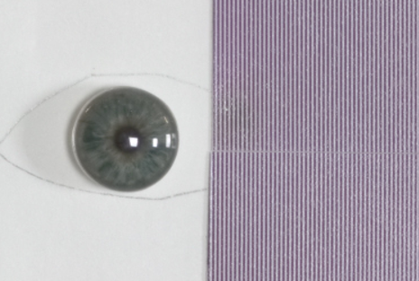
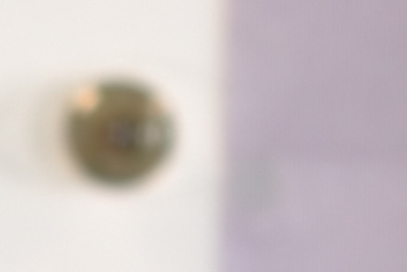
Conventional image capture
Aperture: F/8, Exposure time:
3.43 m
4.04 m
4.65 m
Notes:
Write exposure time,
Mention that the patches has been scaled differently to match ???

Slide 3
Focal stack

Slide 4
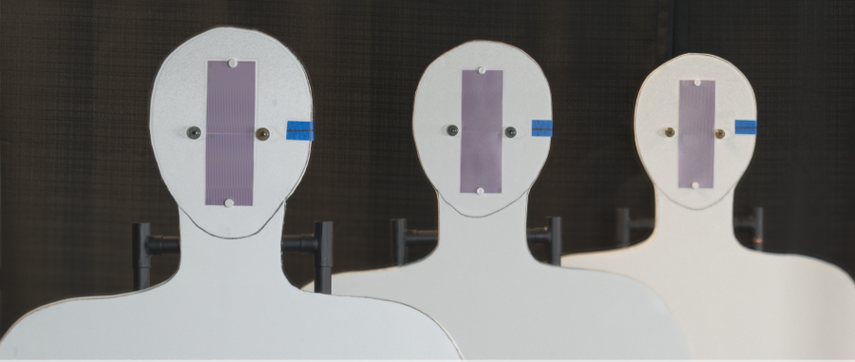
Composite image
Total exposure time: seconds (each image in focal stack captured at F/8)

Slide 5
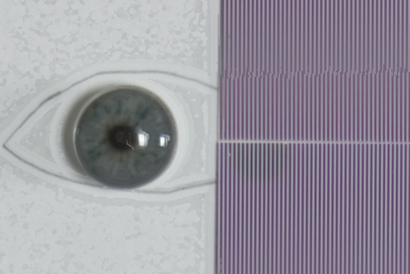
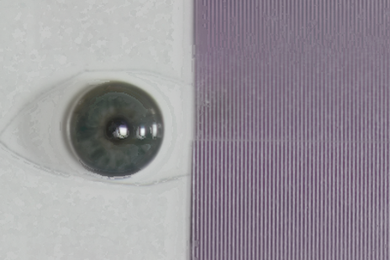
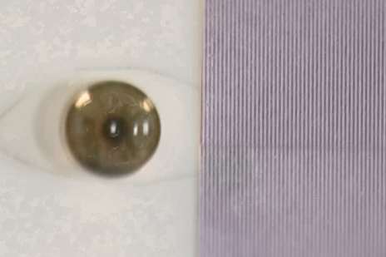
A closer look
Near (3.43 m )
Middle (4.04 m )
Far (4.65 m )
Conventional @ F/8
Angular Focus Stacking
Notes:
Mention that the patches has been scaled differently to match ???

